Slide 1


Social Buzz

Slide 2


Today's agenda
Project recap
Problem
The Analytics team
Process
Insights
Summary

Slide 3

Social Buzz is a fast growing social media unicorn that needs to scale rapidly. Accenture has begun a three – month initial engagement to:
Audit their big data practice.
Provide Recommendations for a Successful IPO.
Analyze of their content categories that highlights the top 5 categories with the largest aggregate popularity.
Project Recap

Slide 4




Problem
Users post over 100,000 pieces of content every day
With tens of millions of posts and hundreds of millions of users, how do you capitalize?

Slide 5




Andrew Fleming
Chief Technology Architect
The Analytics team
Marcus Rompton
Senior Principal
Aniketh Bharat
Data Analyst

Slide 6

Process
1
Data Understanding
2
Data Cleaning
3
Data Modelling
4
Data Analysis
5
Uncover Insights

Slide 7

Insights
16
Unique Category
1897
Reactions to ‘Animal’ Posts
MAY
Month with Most posts

Slide 8
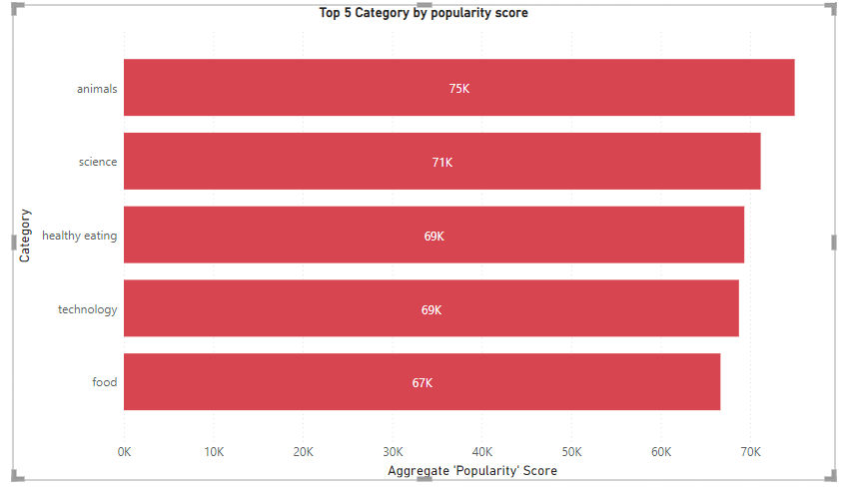

Slide 9
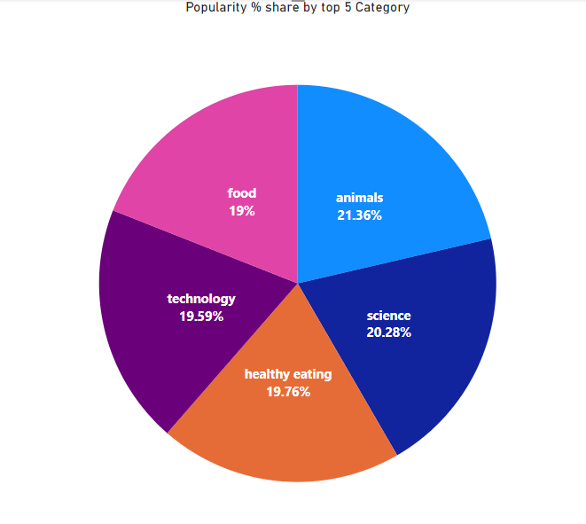

Slide 10
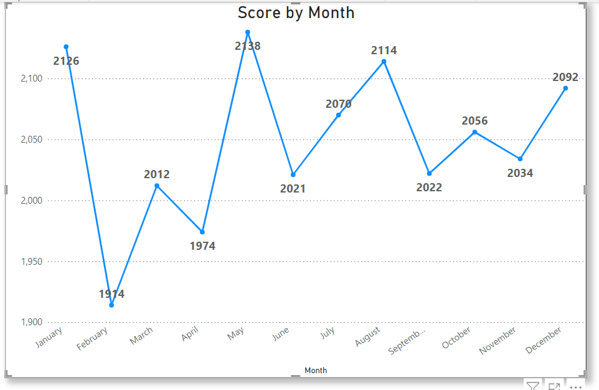

Slide 11

ANALYSIS
Animals and science are two most popular categories of content, showing that people enjoy ‘real-life’ and ‘factual’ content the most.
INSIGHT
Food is the common theme with the top 5 categories with ‘Healthy Eating’ ranking the highest. This may give an indication to the audience within your user base. You could use this insight to create a campaign and work with healthy eating brands to boost user engagement.
NEXT STEPS
This ad-hoc analysis is insightful,but it’s time to take this analysis into large scale production for real-time understanding your business.
Summary

Slide 12

Thank you!
ANY QUESTIONS?

